Slide 1

CUSTOMER SEGMENTATION
Capstone Project on Domain-BFSI
By- Mohit Sinch

Slide 2
Objective of project
The objective of this project is to create a customer segmentation with similar type of data.
The columns that are available in the given data set are as follows.
Age (numeric)
Sex (text: male, female)
Job (numeric: 0 - unskilled and non-resident, 1 - unskilled and resident, 2 -
skilled, 3 - highly skilled)
Housing (text: own, rent, or free)
Saving accounts (text - little, moderate, quite rich, rich)
Checking account (numeric, in DM - Deutsch Mark)
Credit amount (numeric, in DM)
Duration (numeric, in month)
Purpose (text: car, furniture/equipment, radio/TV, domestic appliances, repairs,
education, business, vacation/others)

Slide 3
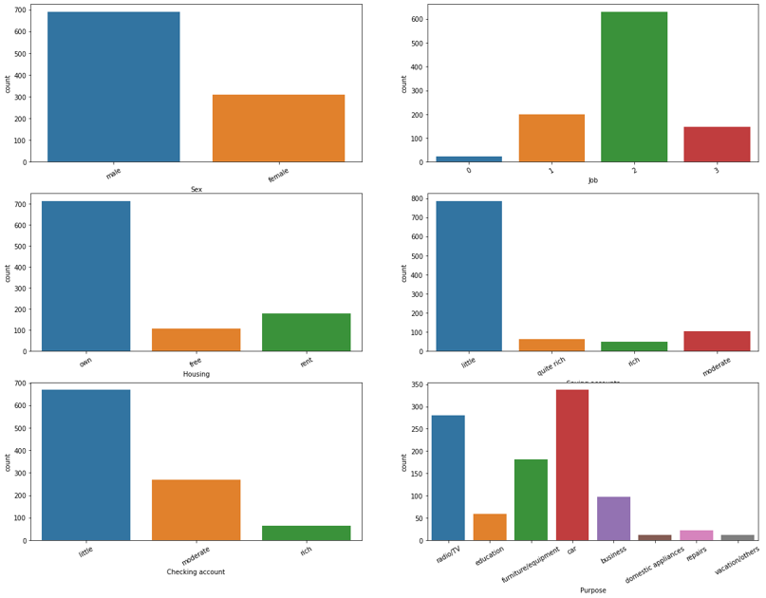
Data Visualization
The purpose of Data visualization is to make data more readable and understandable for the viewer.
Above are the bar plot of all the categorical feature. From the bar plot above, we can get some insight. That are:
The amount of men are greater than women
Most of the customer are skilled on their job
Most of the customer have their own house
Most of the customer have little saving account
Most of the customer have little checking account
Most of the customer use credit for car

Slide 4
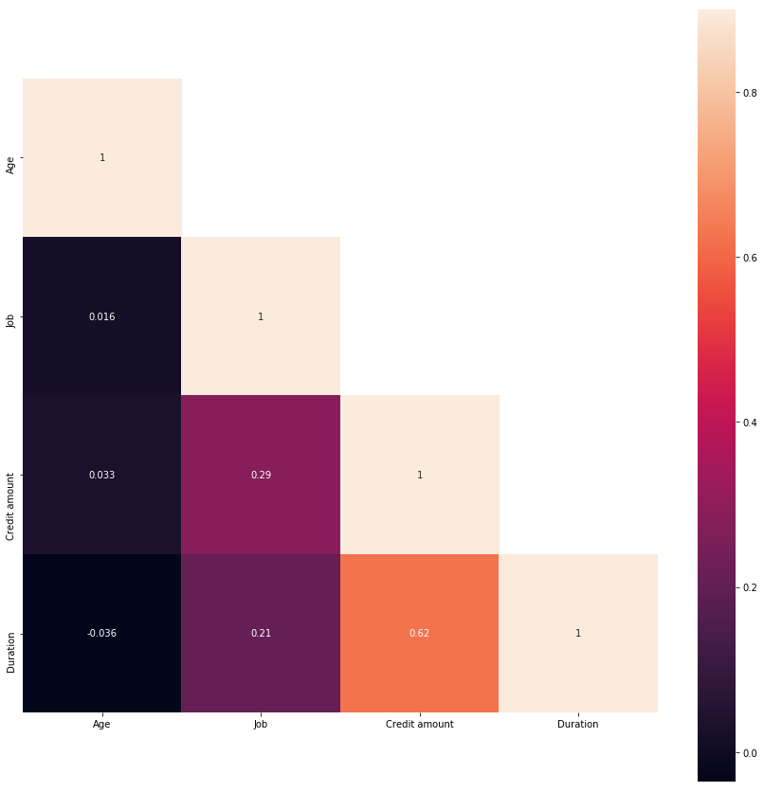
Data Visualization
Replace with your own text
From the heatmap we can see that the best correlation is between credit amount and duration. But so far we will still use all the numeric features for the clustering.

Slide 5
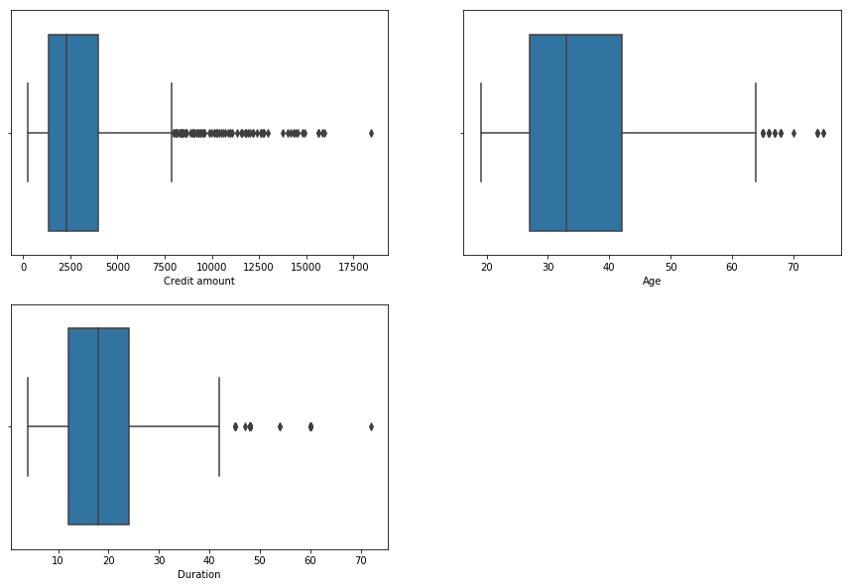
Data Visualization
From the figures we can see that there are still some outliers on the numerical features.

Slide 6
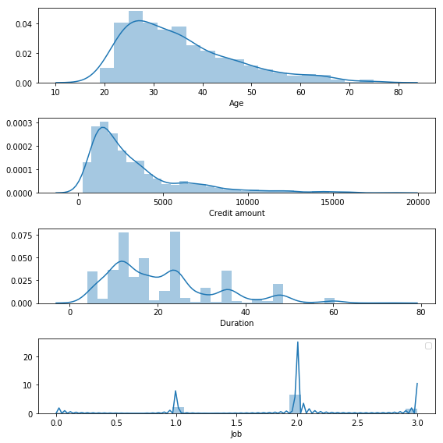
Right skewed data

Slide 7
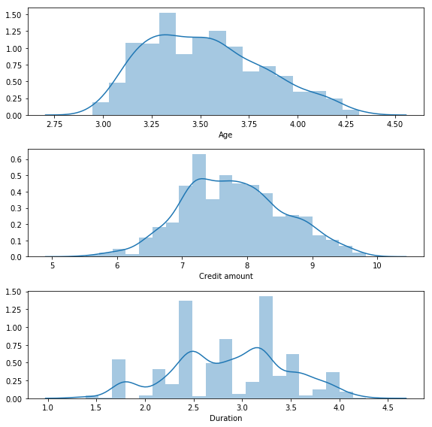
logarithmic Transformation

Slide 8
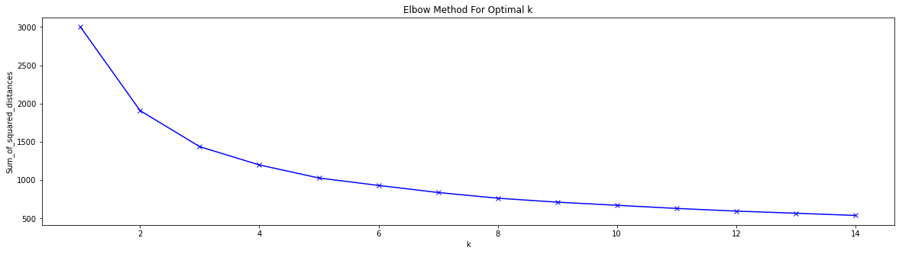
Elbow Method
From the figure above we can see that the most optimal values are 3. So we choose 3 as the k values of the k-means model.

Slide 9
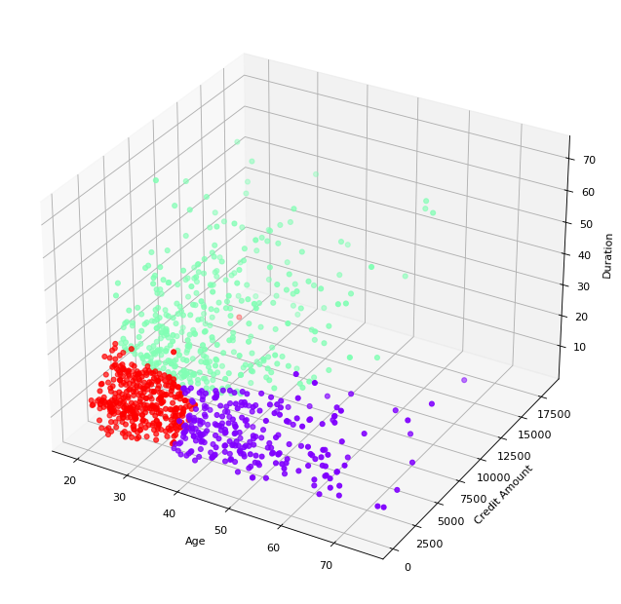
K-Means Clustering
From the figure we could see that the cluster segmented well.
​ Cluster​ ​ | ​ Credit amount​ ​ | Age​ | Duration​ | ​ Job​
0​ | 1732.2​ | 28​ | 14​ | 2​
1​ | 5665.4​ | 34​ | 32​ | 2​
2​ | 1979.7​ | 49​ | 13​ | 2​

Slide 10
Conclusion
From these model, we can choose the most well segmented model, that is k-means. We use the clusters from the that model to analyze the dataset.

Slide 11
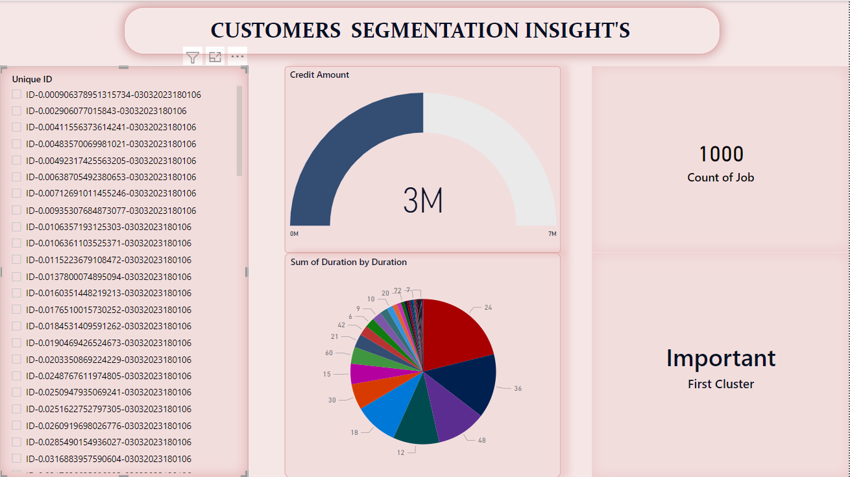
Dashboard:

Slide 12
THANK YOU

